Slide 1
Chapters 6 Iterations

Slide 2

While Statement
A repetition structure, also called iteration, allows us to repeat a block of statements while some condition remains true. This type of flow is called a loop.
The body of the loop should change the value of one or more variables so that eventually the condition becomes false and the loop terminates.
The first line initializes a variable named n, which acts as a counter or loop variable. As the loop executes, the value of n increases by 1 from 0 to 10.
If the condition is always true, the loop will repeat forever, which is called an infinite loop. Ctrl-C to stop an infinite loop.
If the condition is false the first time through the loop, the statements inside the loop are never executed.

Slide 3
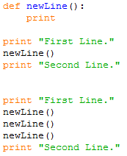
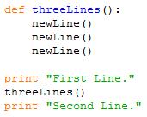
Remember the newLine() Function?!
Achieve the same result using a while loop.

Slide 4

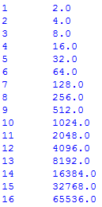

Escape Sequences
Escape sequences are used to represent different characters such as tabs, newlines, single-quote or double-quote. An escape sequence can appear anywhere in a string; in the example, the tab escape sequence is the only thing in the string.
Modify the program so that it outputs the powers of two up to 65,536 (that’s 216).
The sequence \n represents a newline, \’ escapes a single-quote and \” escapes a double-quote .

Slide 5
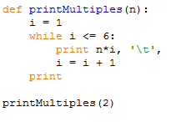



Encapsulation and Generalization
Encapsulation is the process of wrapping a piece of code in a function.
Generalization means taking something specific, such as printing the multiples of 2, and making it more general, such as printing the multiples of any integer.
The function printMultiples(n) encapsulates the while loop above and generalizes it to print multiples of n.
Replace the print statement with a function call to print a multiplication table.

Slide 6
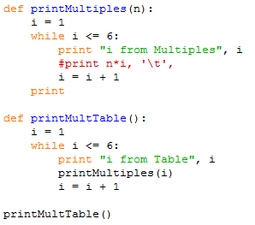
Local Variables
Variables created inside a function definition are local; you can’t access a local variable from outside its “home” function.
We can have multiple variables with the same name as long as they are not in the same function.

Slide 7
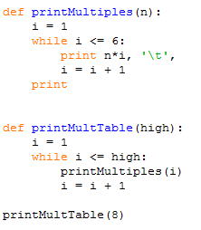
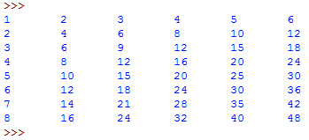
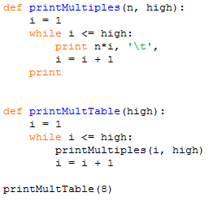
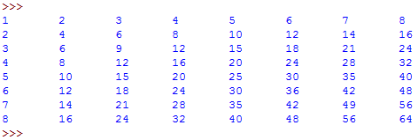
More Generalization
Print a multiplication table of any size, not just the six-by-six table.
For the table to be square - with the same number of rows and columns - add another parameter to printMultiples to specify how many columns the table should have.

Slide 8
Chapter 7 Strings

Slide 9
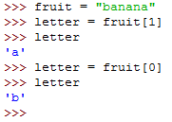
Compound Data Types
Data types that comprise smaller pieces are called compound data types.
Strings are qualitatively different from integer and float because they are made up of smaller pieces—characters.
The bracket operator selects a single character from a string.
To get the first letter of a string, you just put 0, or any expression with the value 0, in the brackets.
The expression in brackets is called an index. An index specifies a member of an ordered set, in this case the set of characters in the string.
The index indicates which one you want, hence the name. It can be any integer expression.

Slide 10
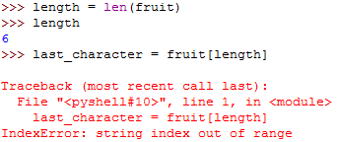

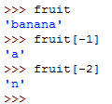
Len Function
The len function returns the number of characters in a string:
To get the last character, we have to subtract 1 from length:
We can use negative indices, which count backward from the end of the string.

Slide 11



The For Loop
A lot of computations involve processing a string one character at a time.
The for loop has a simpler syntax:
Each time through the loop, the next character in the string is assigned to the variable char. The loop continues until no characters are left.

Slide 12
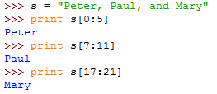
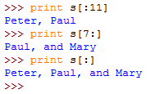
String Slices
A segment of a string is called a slice.
The operator [n:m] returns the part of the string from the “n-eth” character to the “m-eth” character, including the first but excluding the last.
If you omit the first index (before the colon), the slice starts at the beginning of the string. If you omit the second index, the slice goes to the end of the string. Thus:

Slide 13
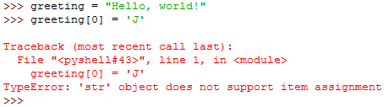

Strings are Immutable
Strings are immutable, which means you can’t change an existing string.
As shown below, you can create a new string by concatenating a new first letter onto a slice of greeting. This operation has no effect on the original string.

Slide 14
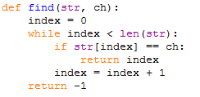
Find Function
It takes a character and finds the index where that character appears in the string.
If the character is found, the function returns the index and breaks out of the loop prematurely.
If the character is not found, then the program exits the loop normally and the function returns -1.

Slide 15
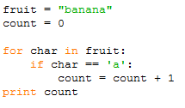
Looping and counting
The following program counts the number of times the letter a appears in a string:
This program demonstrates another pattern of computation called a counter.
The variable count is initialized to 0 and then incremented each time an “a” is found.
When the loop exits, count contains the result—the total number of a’s.

Slide 16


The String Module
The string module contains useful functions that manipulate strings.
The string module includes a function named find that does the same thing as the function we wrote.
We use dot notation to call a function from a module. Even though the built-in function has the same name as the function we wrote, by using dot notation we can specify which version of find we want.
Actually, string.find is more general than our version. It can find substrings, not just characters:
Also, it takes an additional argument that specifies the index it should start at:
Or it can take two additional arguments that specify a range of indices:

Slide 17
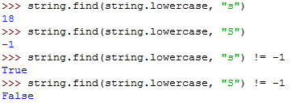

Character classification
The string.lowercase constant contains all of the letters that the system considers to be lowercase.
The string.uppercase constant contains all of the uppercase letters.
We can use these constants and find to classify characters. If find returns a value other than -1, then ch must be lowercase:

Slide 18


Character classification Cont.
The in operator, which determines whether a character appears in a string:
Or use the comparison operator. If ch is between a and z, it must be a lowercase letter.

